Slide 1
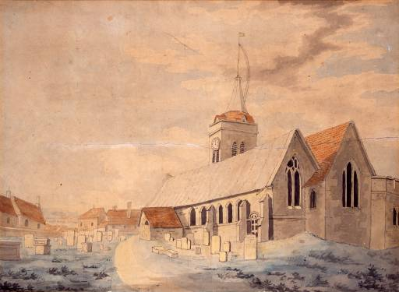
St. John’s Church, Margate watercolour
1786
Turner was 11 when he depicted this watercolour.
He was a son of a barber in Convent garden. His mother was born in a family of butcher.
Trailer del film: Mr. Turner (2014)

Slide 2
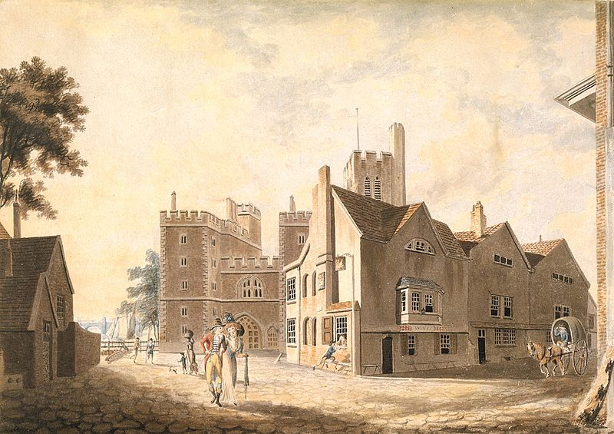
A View Of The Archibishop Palace watercolour
1790
He was admittedt to the Royal Academy Schools at the age of 15, and soon started to exhibit.
He began his career as a topographical watercolour painter.
He made many sketchig tours through Britain in connection with the topographical engravings that provided him with the financial security even when his paintings outstripped contemporary taste.

Slide 3
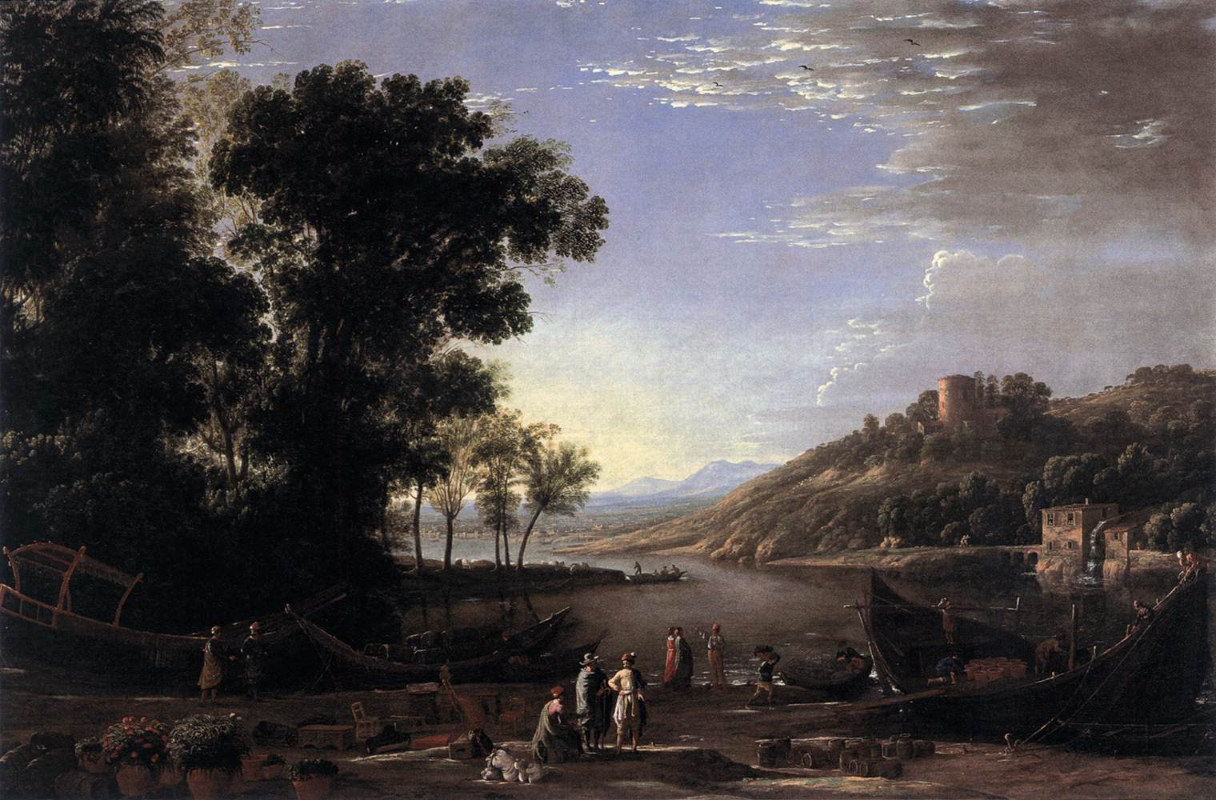
Claude Lorrein
Landscape with Merchants
1630
He was a great fan of the landscape Ancient Masters expecially Claude Lorrain (a French painter of the 17° century) van de Velde (dutch painter of sea-pieces) and Poussin (historical landscape painter)

Slide 4
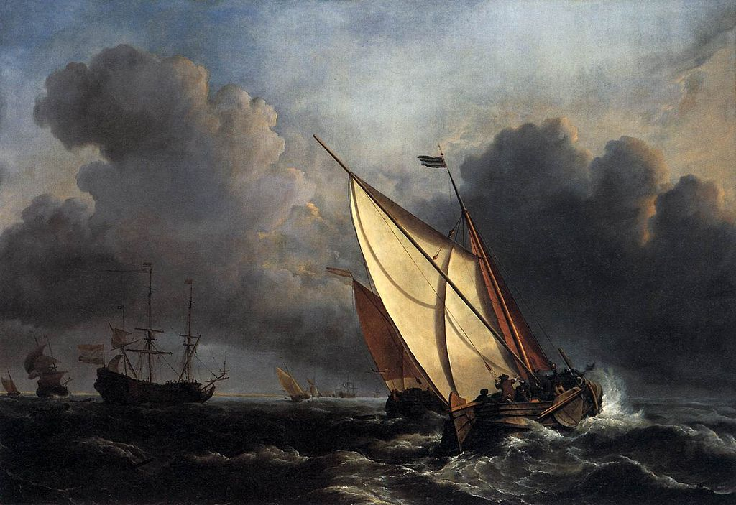
Willem van de Velde the Younger
Ships on a Stormy Sea
1672

Slide 5
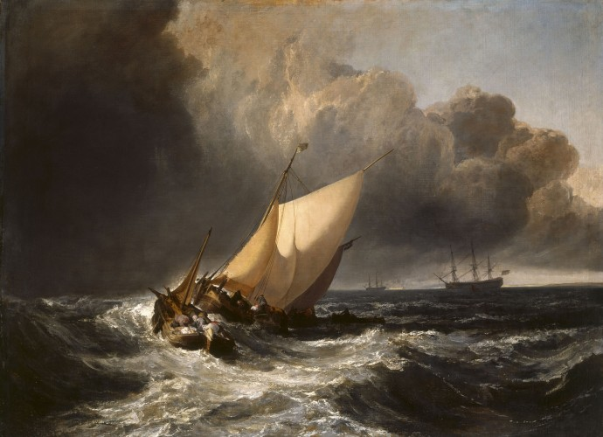
Dutch Boats in a Gale (the Bridgwater Sea Piece)
1801
He wanted to emulate the works of the accepted Old Masters so he painted sea-pieces in the manner of van de Velde, italianate landscape in the manner of Claude Lorrain and «historical» landscape in the manner of Poussin
Turner soon digested the lessons of his predeccessors, making their themes his own and trating them in a completely personal manner

Slide 6
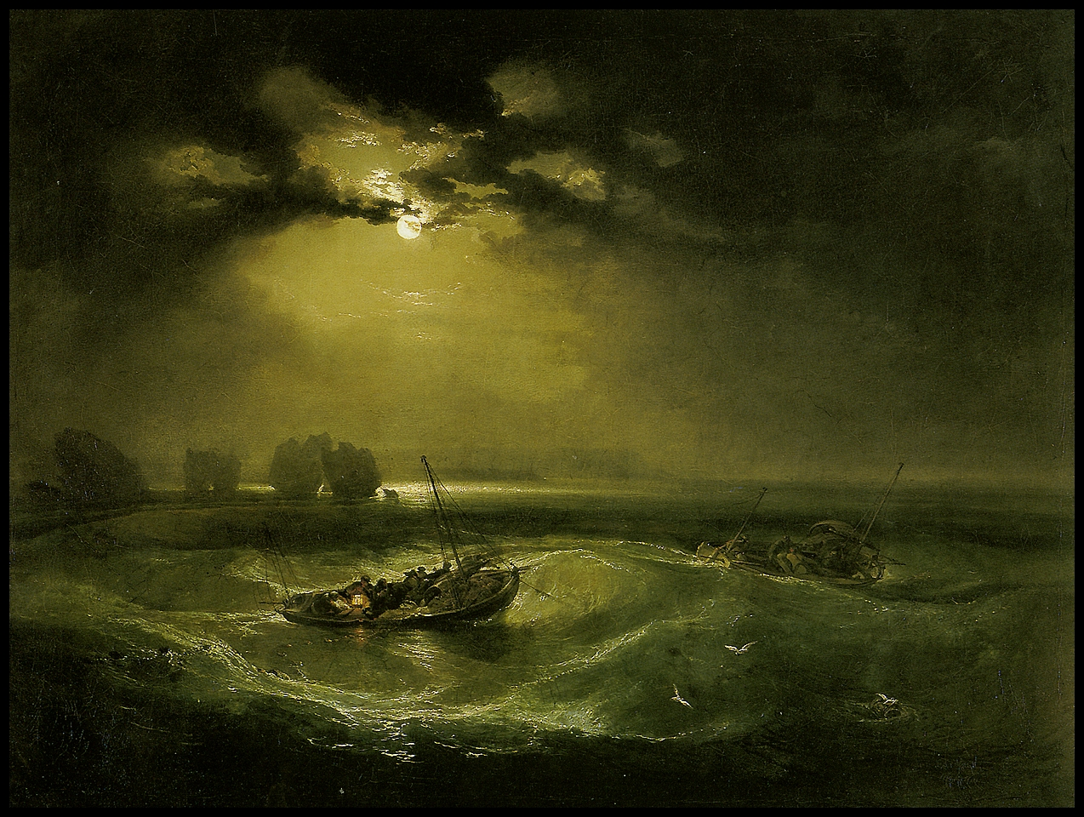
Fishermen at Sea
Oil on canvans, 91x122
London, tate Gallery
1797
The Genius of Turner ¼
Ship, Shipwrecks, storm, vapour, fire, rain, steam-boats, sea, wind, sunlight, fog and in general natural phenomena are vehicles for Turner’s imagination

Slide 7
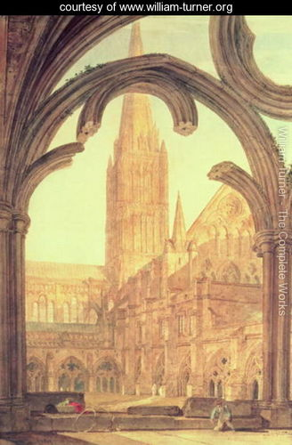
Veduta dal chiostro della cattedrale di Salisbury
Matita e acquerello, 68x49
London, Victoria and Albert Museum
1802

Slide 8
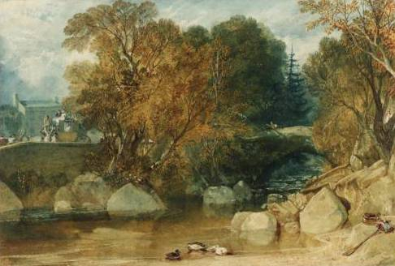
Ivy Bridge watercolour
1813

Slide 9
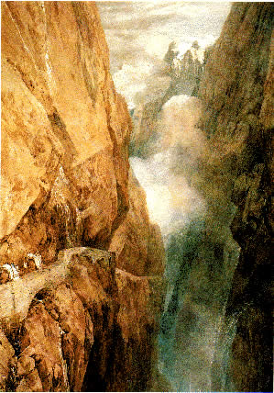
The Hell’s Bridge at St. Gothard
Oil on canvans, 77x63
Zurich, Kunsthalle
1804

Slide 10
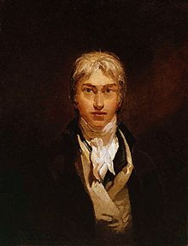
Self-portrait
Oil on canvans,
1799
The Genius of Turner 2/4

Slide 11
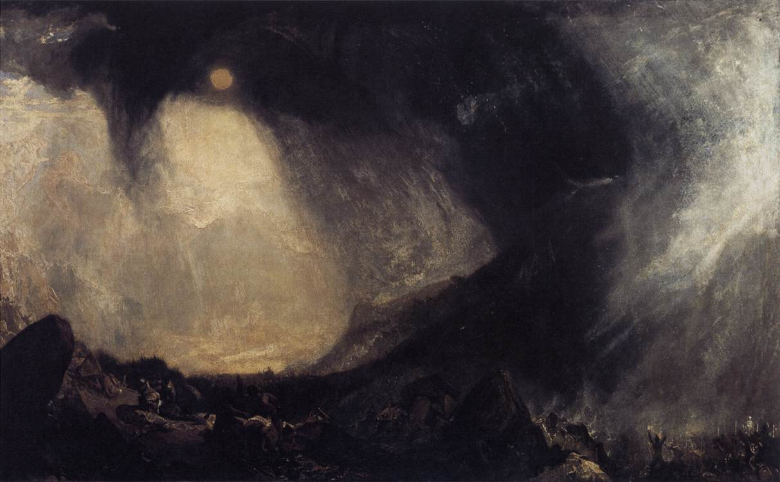
Snow Storm: Hannibal And His Army Crossing The Alps
Oil on Canvans, 145x236
London, Tate Gallery
1812

Slide 12
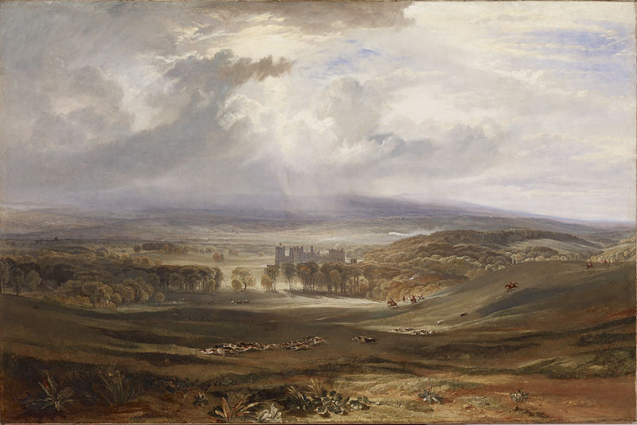
Raby Castle, the Seat of the Earl of Darlington

Slide 13
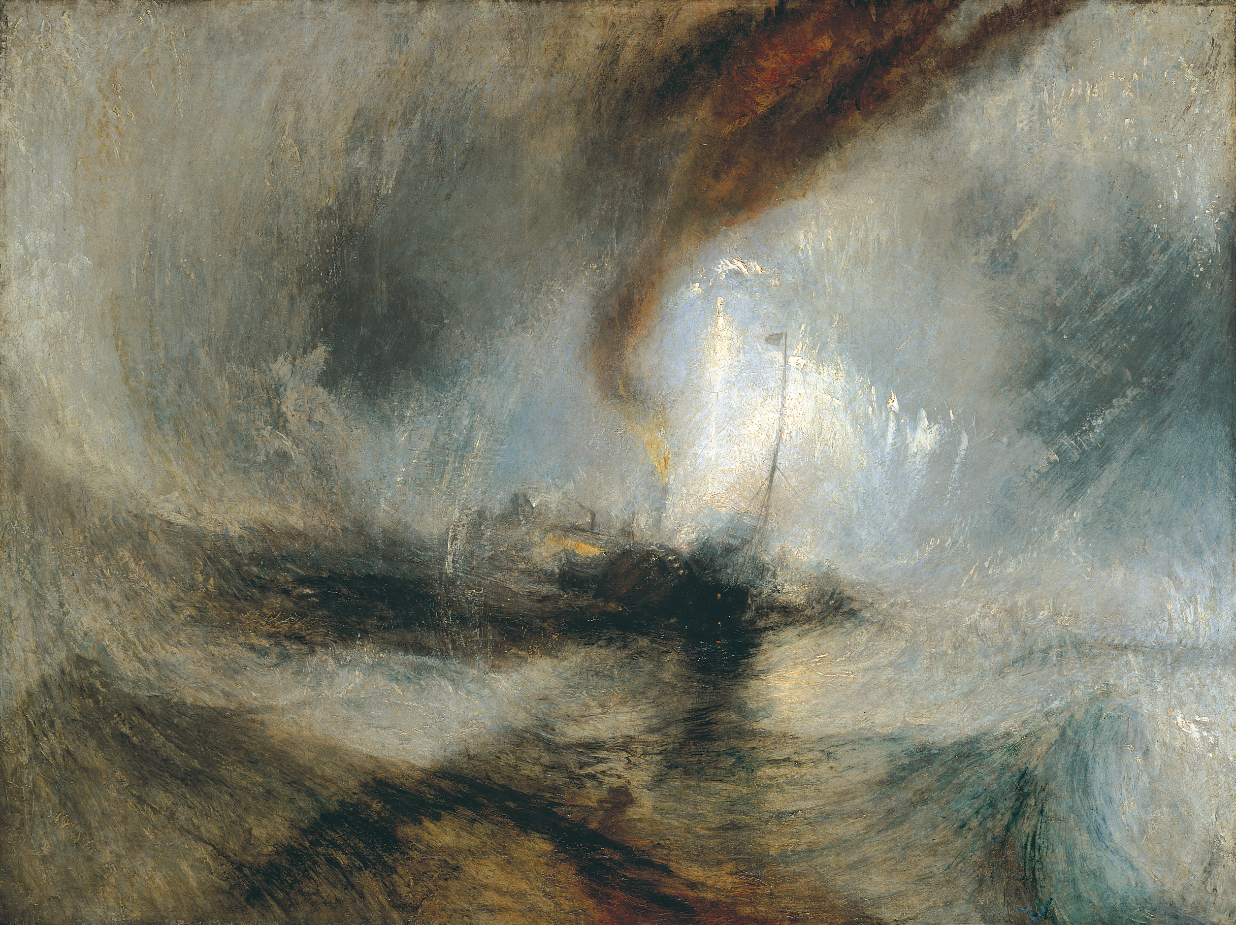
Snow Storm. Steam-Boat off a Harbour’s Mouth 1842
The Genius of Turner 3/4

Slide 14
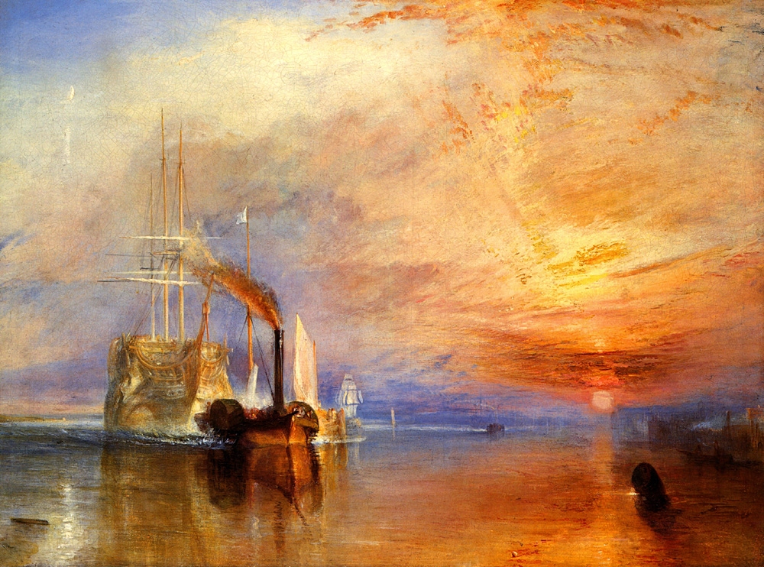
The Fighting Temeraire tugged to her last berth to be broken up oil on canvans – 91x122 cm
London, National Gallery
1839
http://Descrizione della National gallery
Man and Nature.
Machinery and sunset
The glorius old ship and the small steam-boats
Fire and atmosphere
Reflections on the sea
Industrial revolution

Slide 15
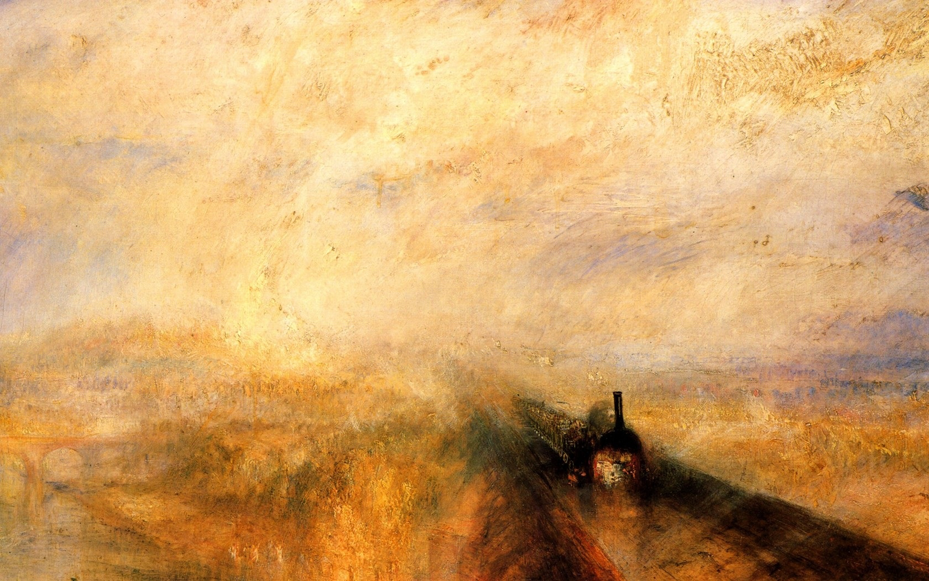
Rain, steam and speed. The Great Western Railway
Oil on canvans, 91x122
London, National Gallery
1844
The Genius of Turner 4/4

Slide 16
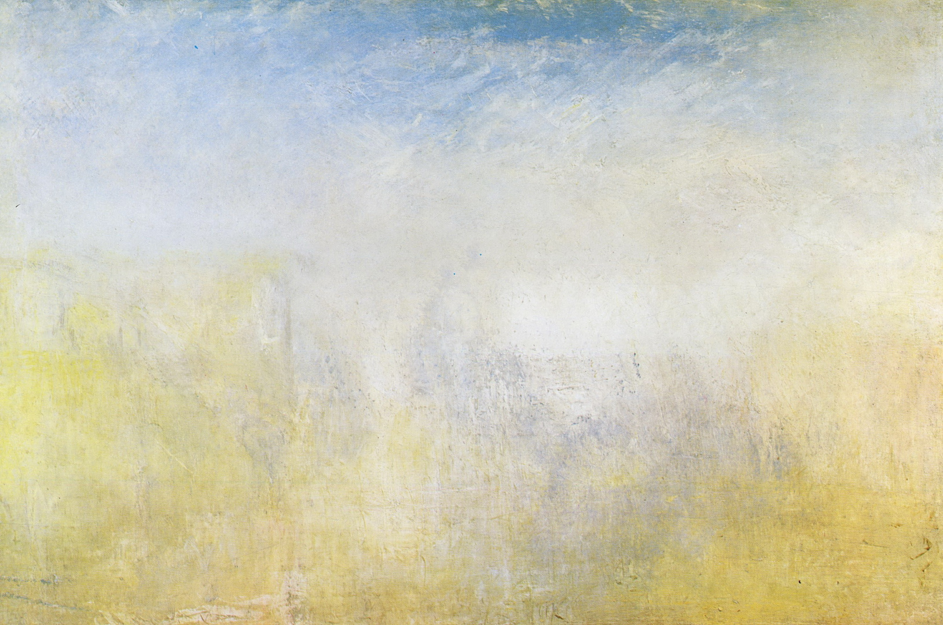
Venice With The Salute
1840
The idyllic, dream-like landscapes, often of Venice, represented one side of Turner’s late style.
The other was the destructivness of nature

